Slide 1
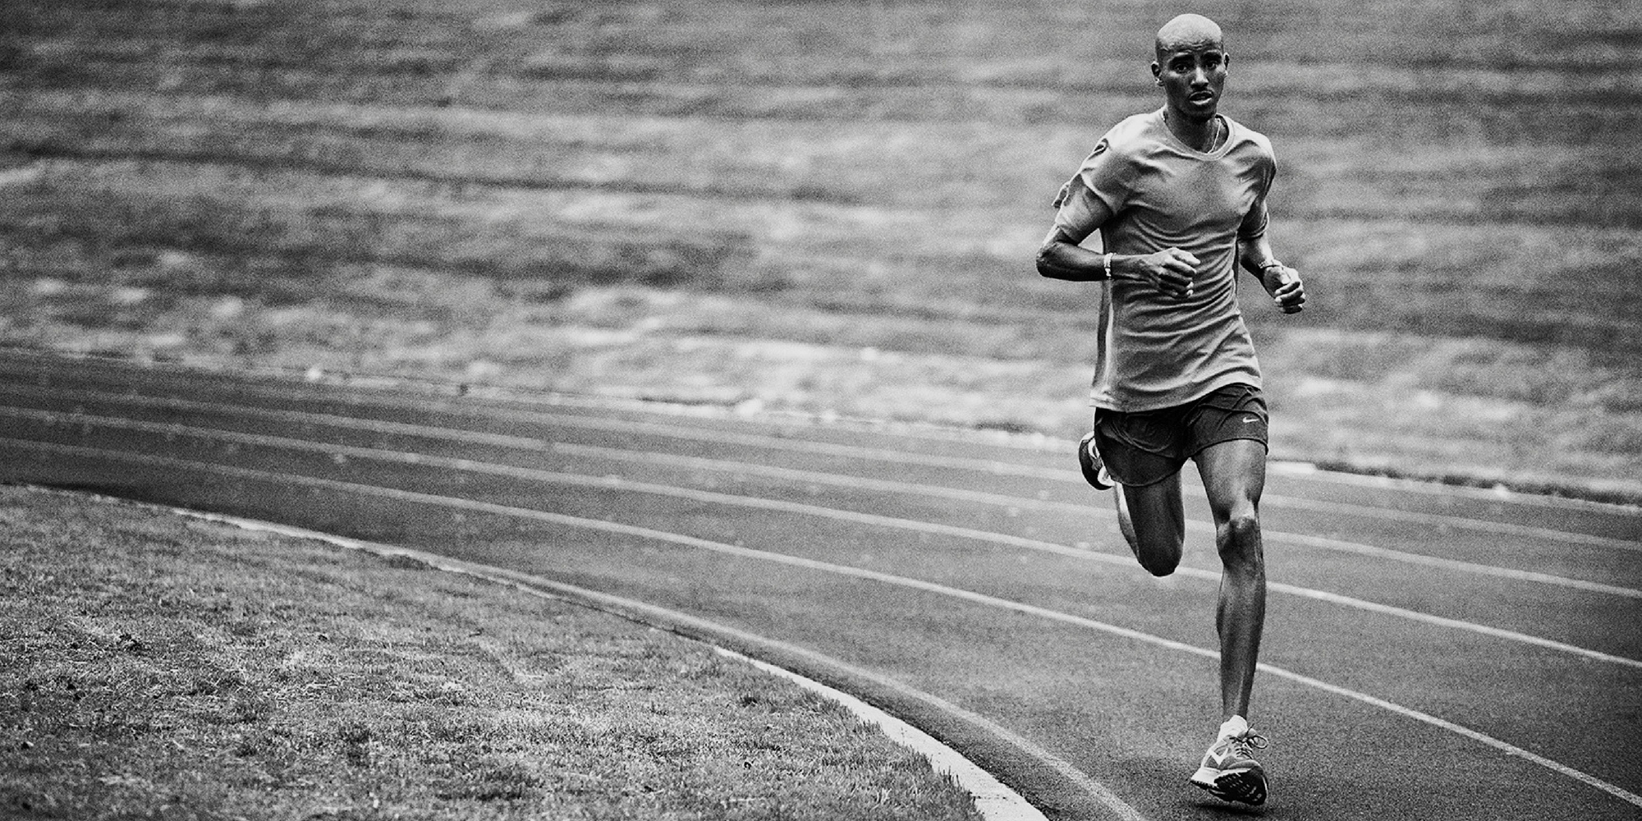
Detecting Athletic Movements With Smart Apparel
D. Alex Lou
Data Scientist | Economist

Slide 2
What’s Currently on the Market?

Slide 3
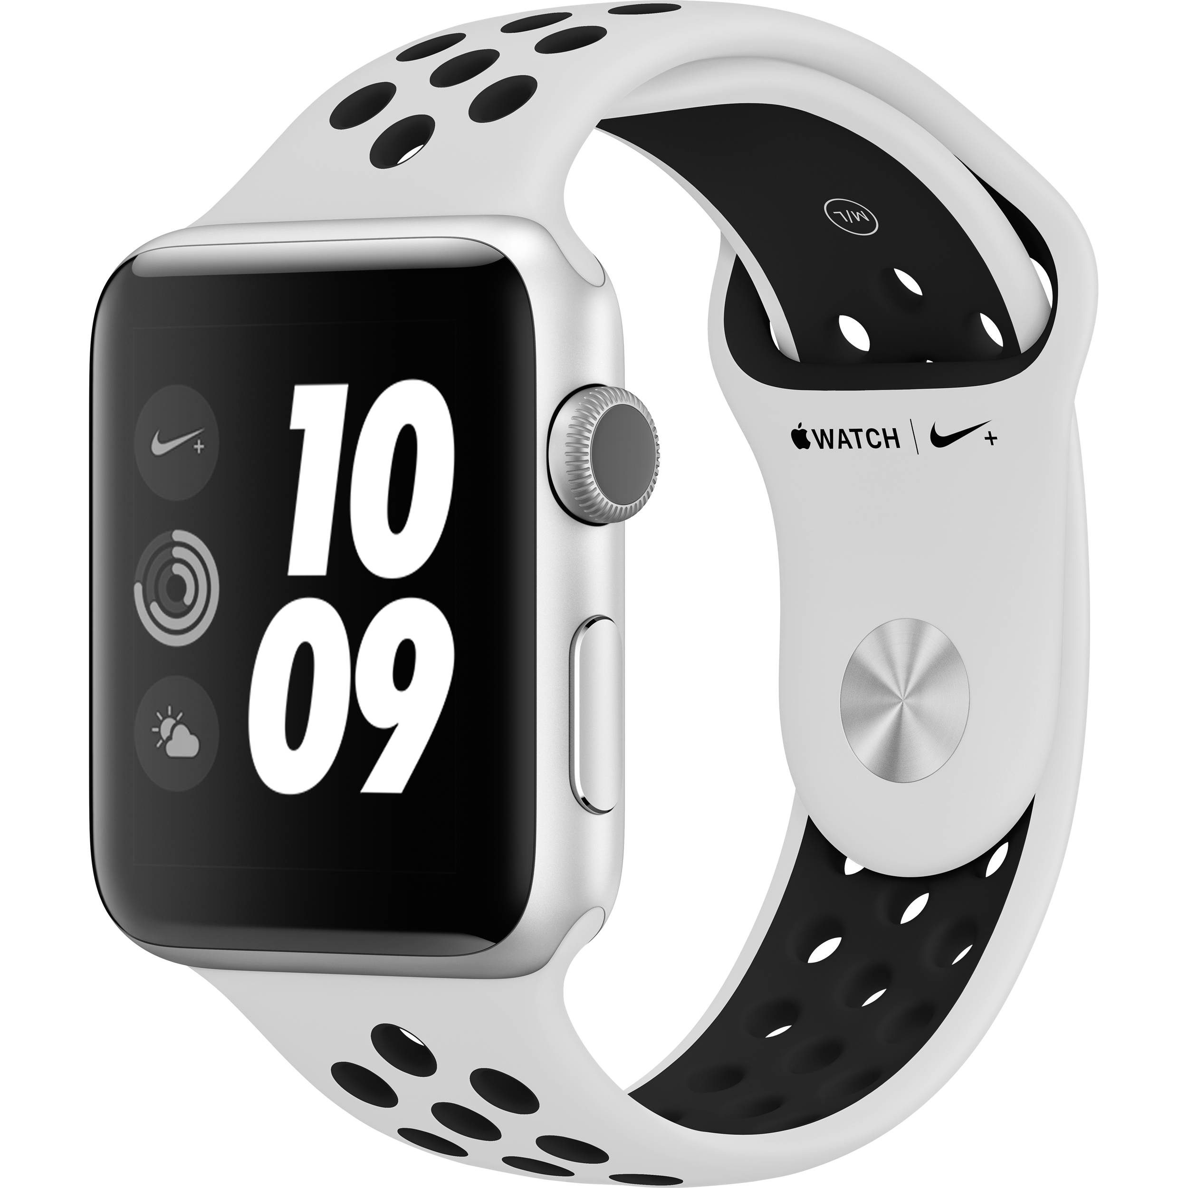
What’s Currently on the Market?
Notes:
Why does my garmin think that I’m walking while im brushing my teeth.

Slide 4
What’s Currently on the Market?
Single Sensor – Inertial Measurement Unit (I.M.U.)
Notes:
X Y Z

Slide 5
What If Instead…

Slide 6
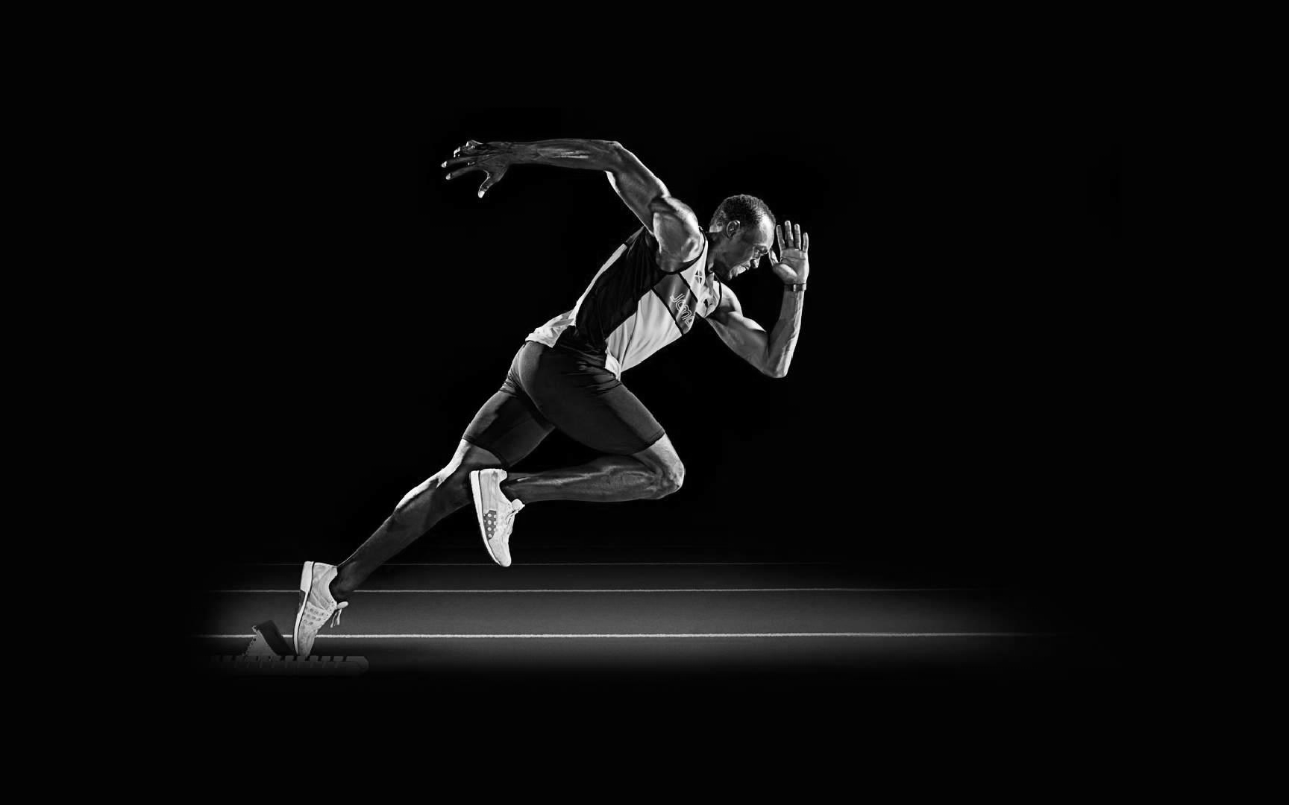
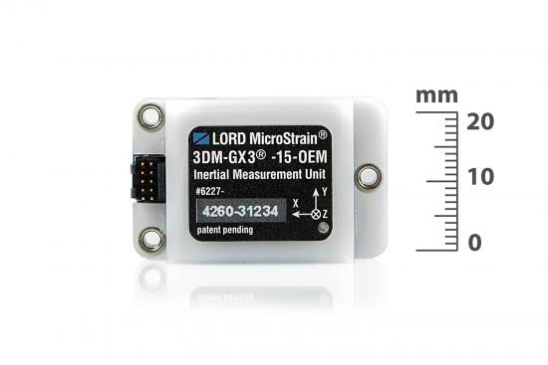
What If Instead…

Slide 7
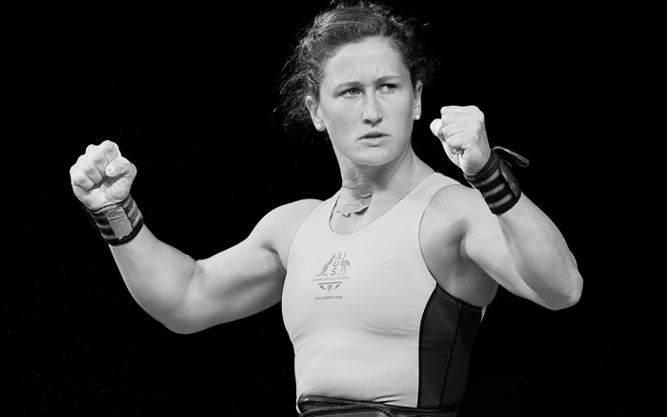
Data
UCI Machine Learning Repository

Slide 8
Data
UCI Machine Learning Repository
9 Different Simultaneous I.M.U. Sensors
17 Different Human Subjects

Slide 9
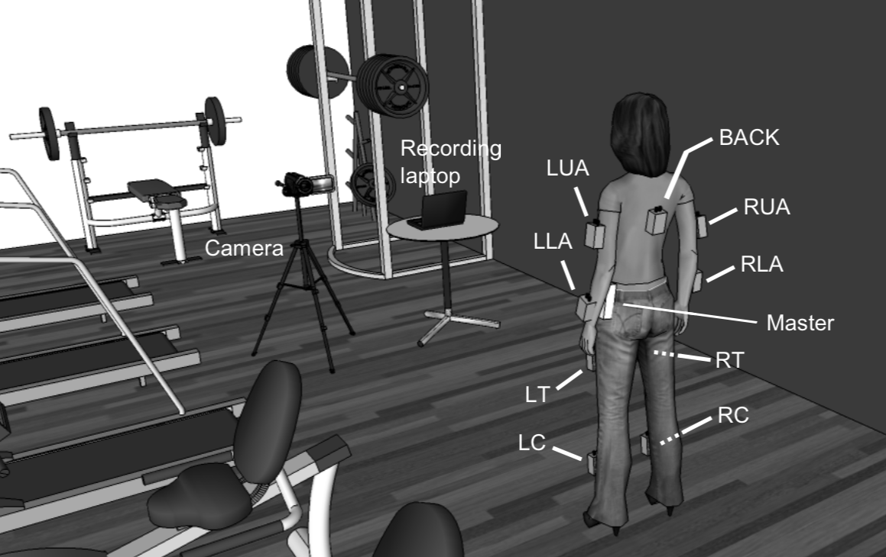
Data
UCI Machine Learning Repository
9 Different Simultaneous I.M.U. Sensors
17 Different Human Subjects
2.6 Million Rows
120 Columns

Slide 10
Data
UCI Machine Learning Repository
9 Different Simultaneous I.M.U. Sensors
17 Different Human Subjects
2.6 Million Rows
120 Columns

Slide 11
Data
UCI Machine Learning Repository
9 Different Simultaneous I.M.U. Sensors
17 Different Human Subjects
2.6 Million Rows
120 Columns
Key Note:
Panel Data (Time-Series Data For Each Subject)

Slide 12
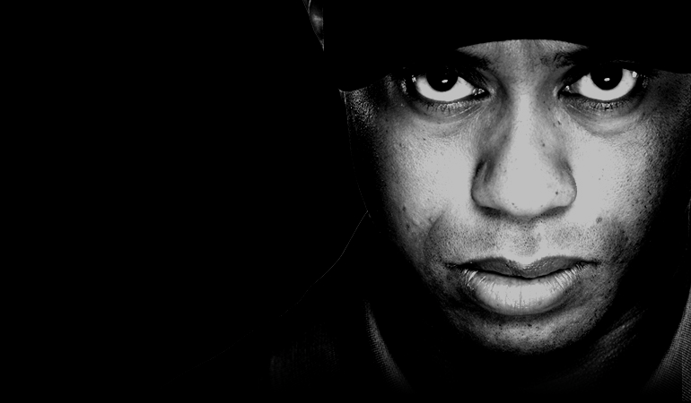
Data

Slide 13
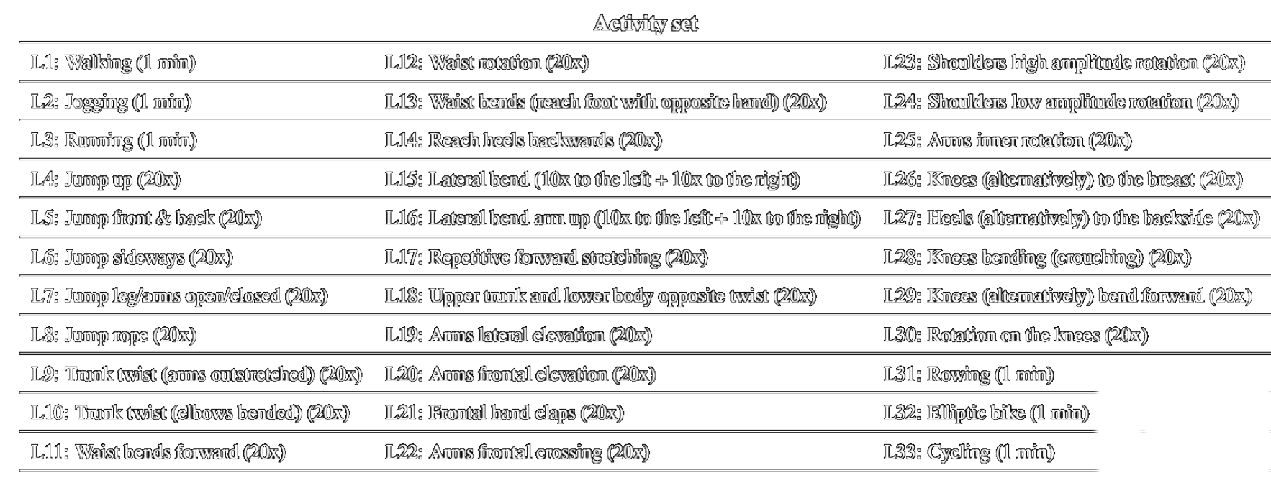
Data

Slide 14
Data

Slide 15
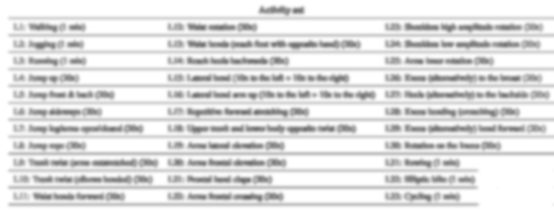
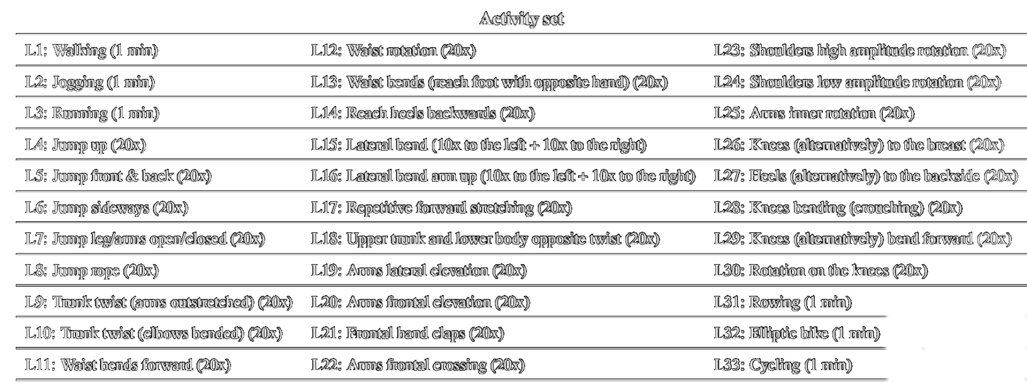
Data
Notes:
Yellow

Slide 16
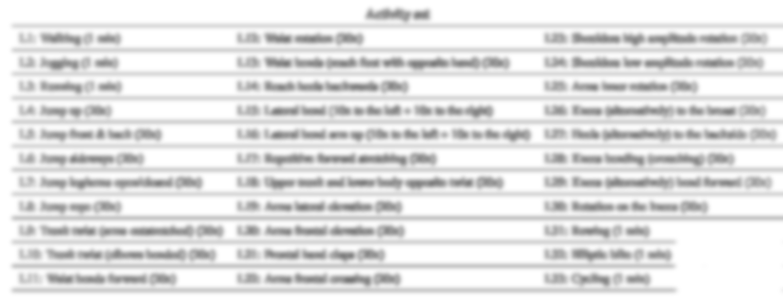
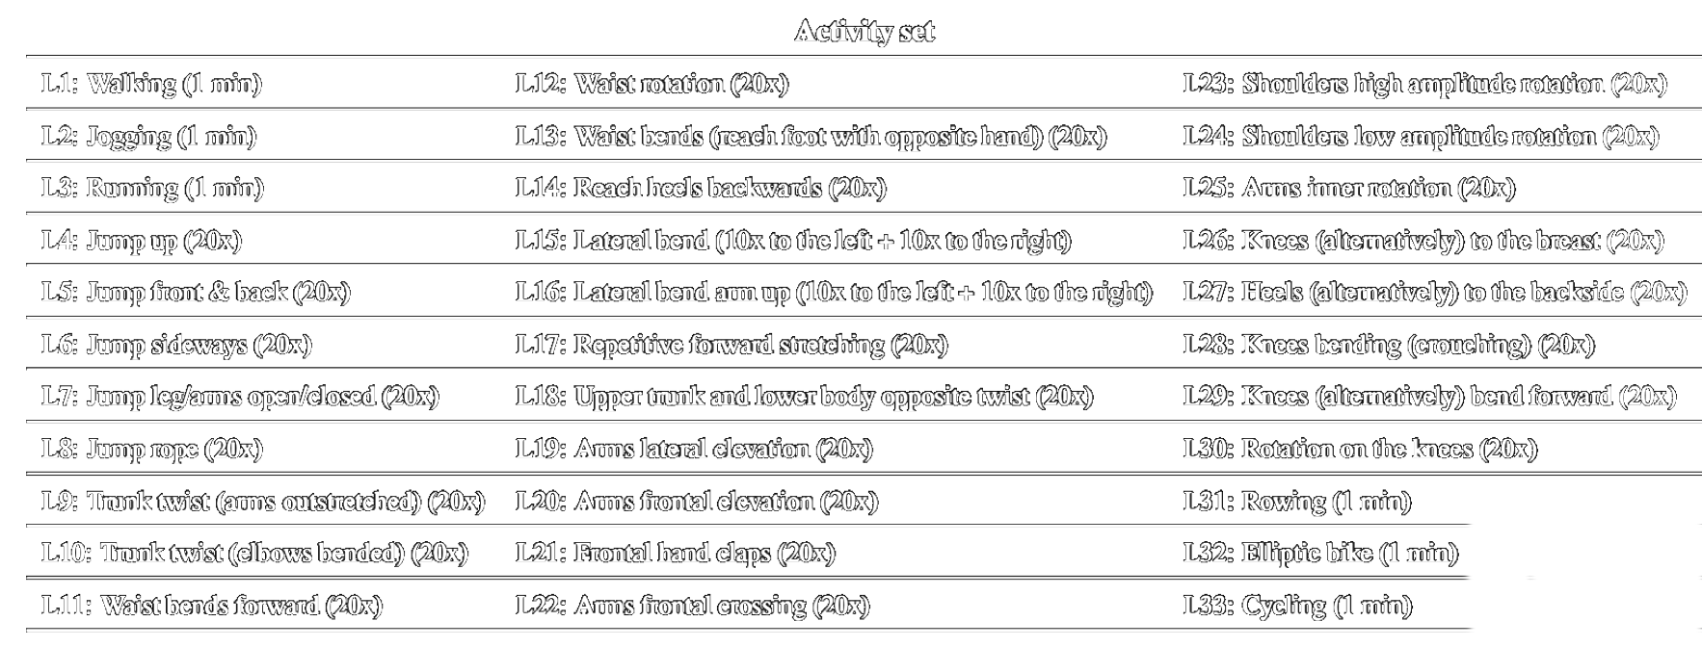
Data
Notes:
Yellow

Slide 17
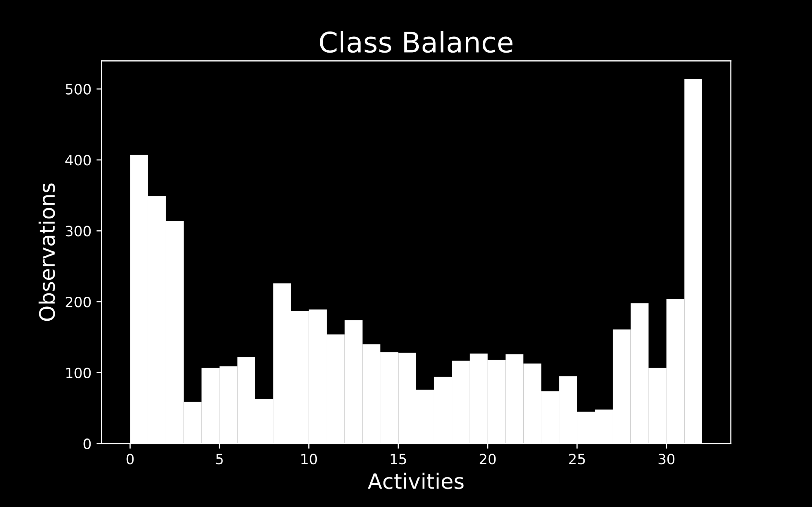
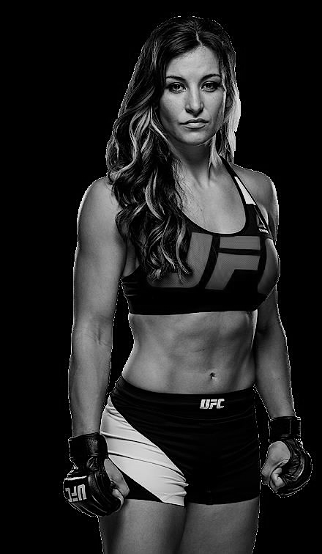
Class Imbalance
Notes:
Ask me questions at the end about class imbalance

Slide 18
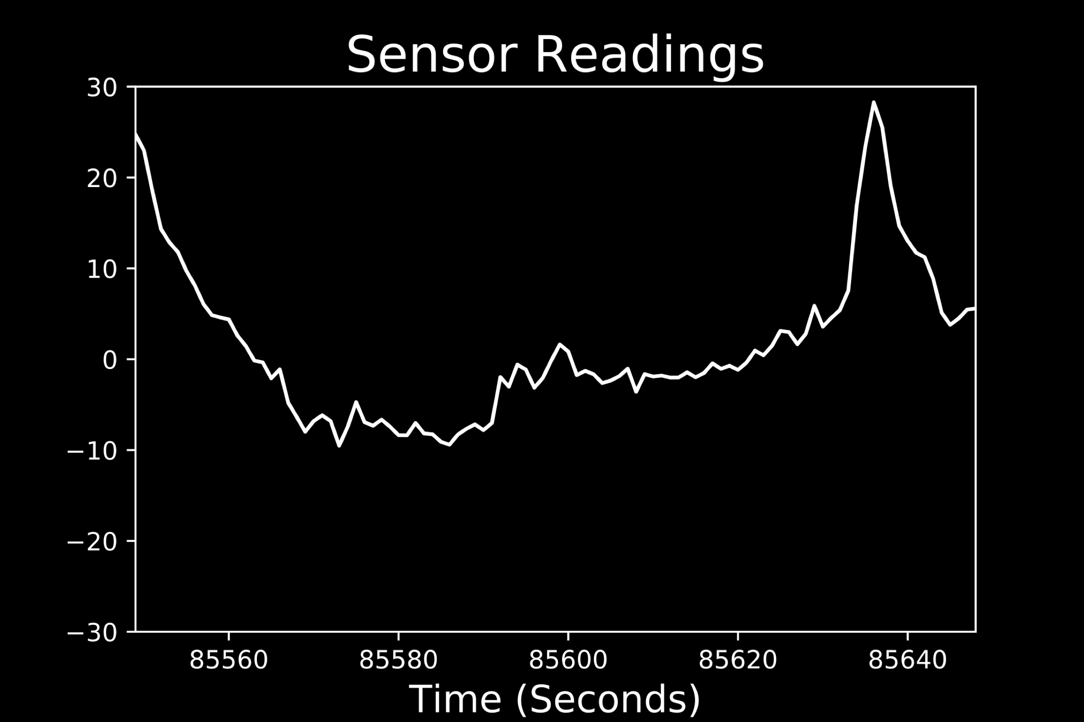

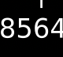

Raw Sensor Reading
.
.

Slide 19
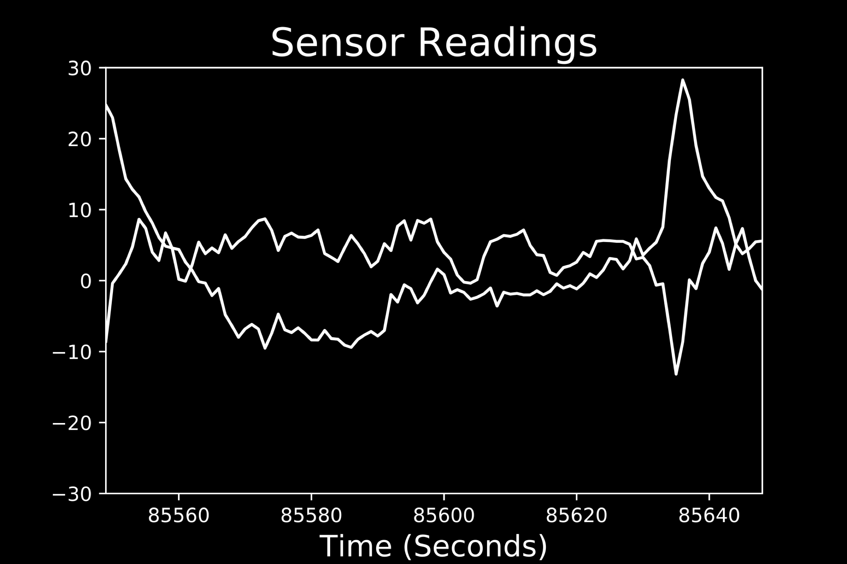
Raw Sensor Reading
.
.

Slide 20
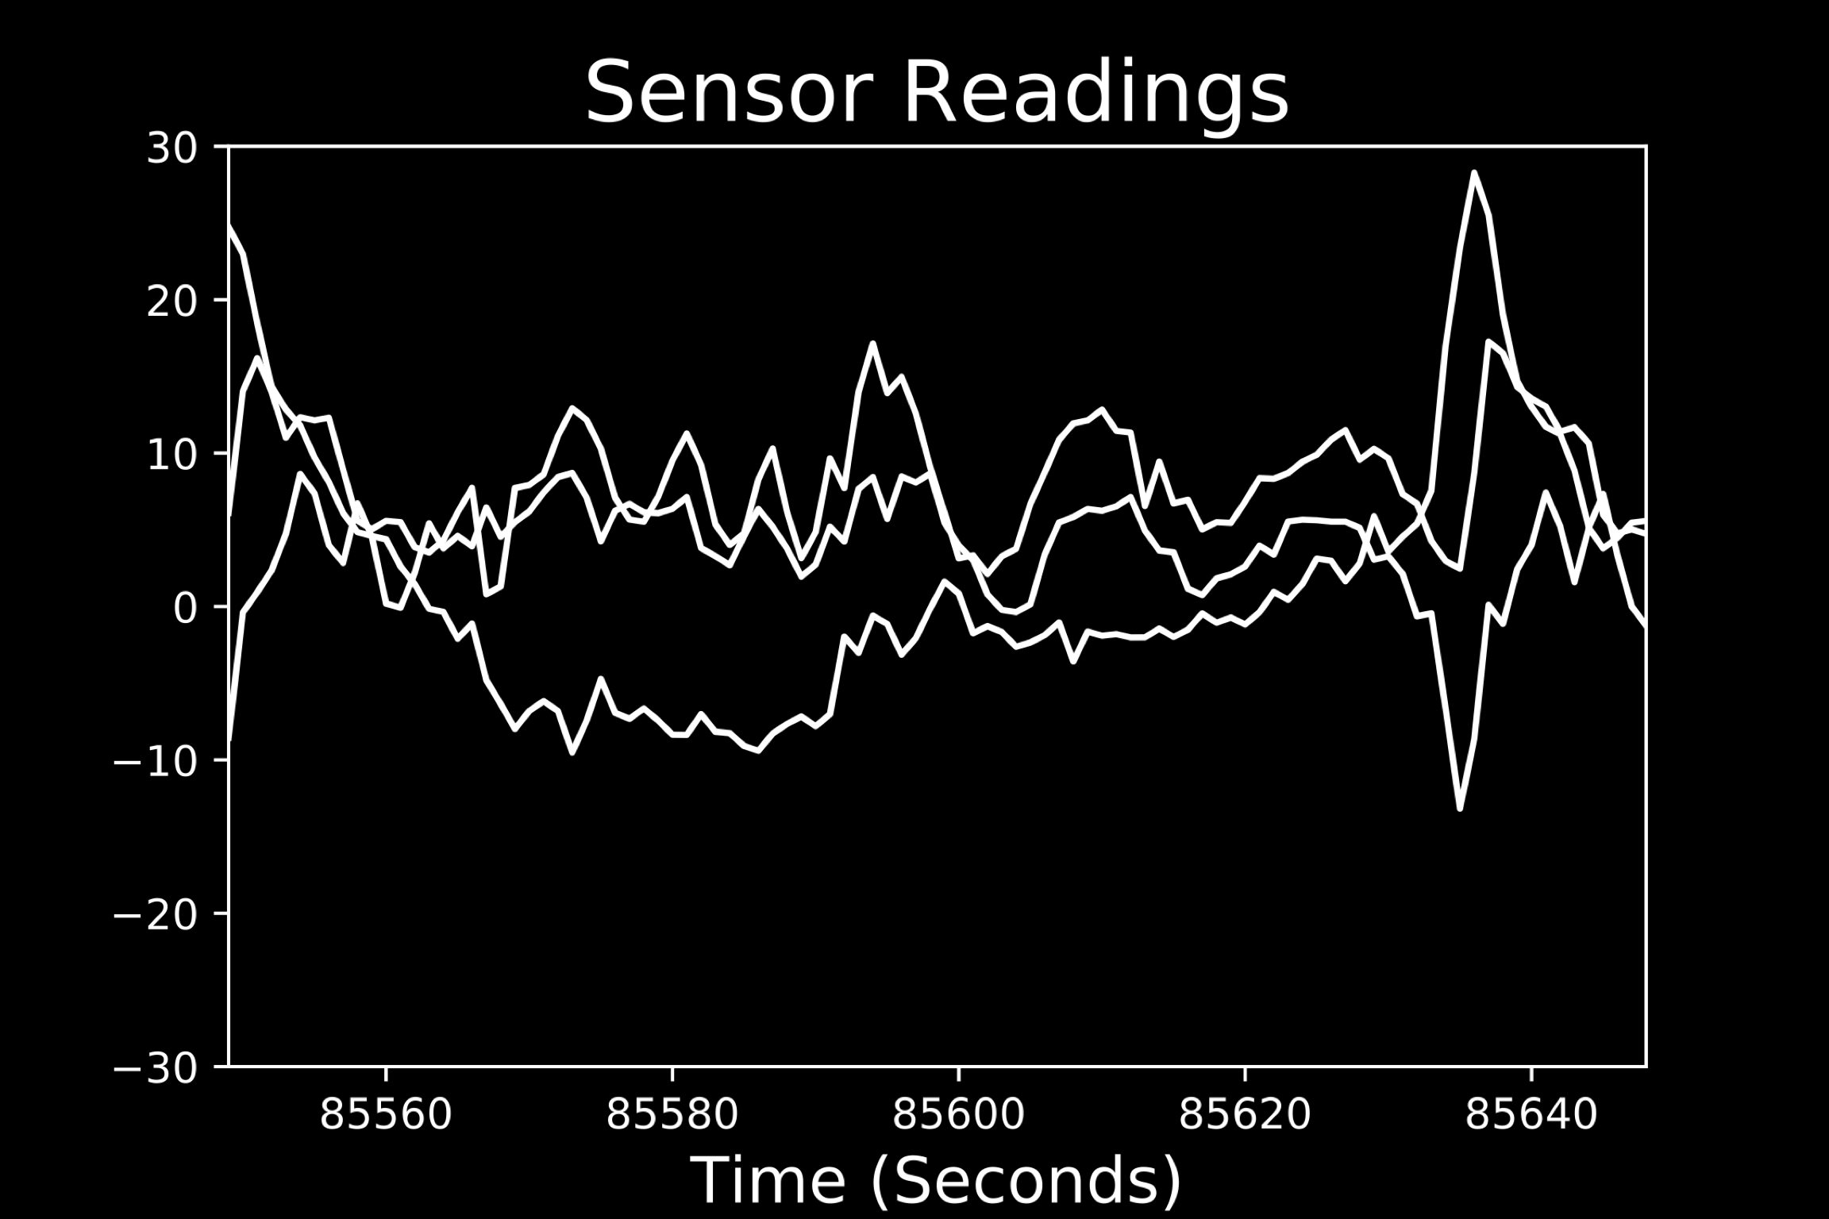
Raw Sensor Reading
.
.

Slide 21
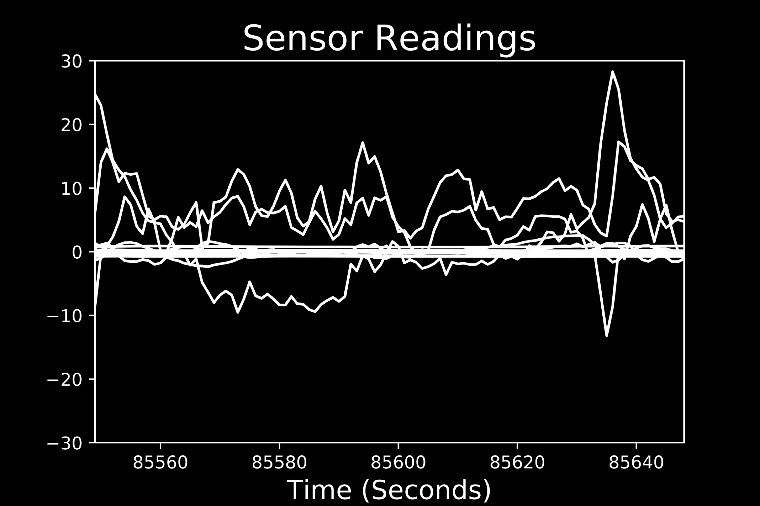
Raw Sensor Reading
.
.

Slide 22
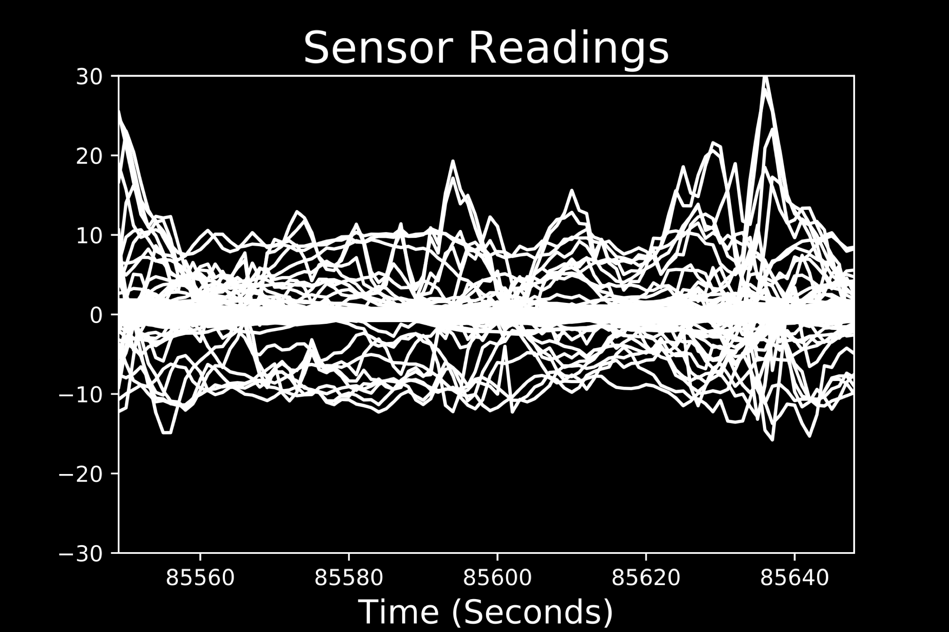
Raw Sensor Reading
.
.

Slide 23
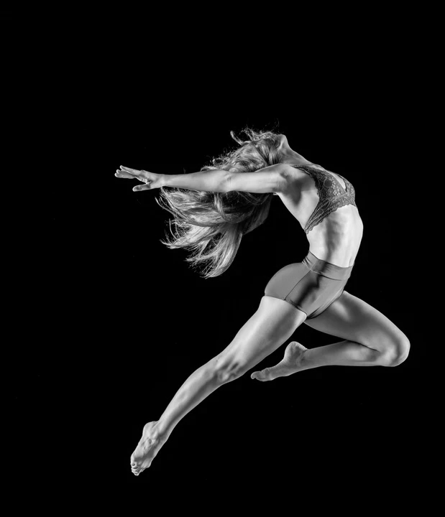
Model
A.I. Deep Learning Model

Slide 24
Model
A.I. Deep Learning Model
LSTM – Neural Network

Slide 25
Model
A.I. Deep Learning Model
LSTM – Neural Network
Handles times series data well

Slide 26
Model
A.I. Deep Learning Model
LSTM – Neural Network
Handles times series data well
Scales well with large amounts of data

Slide 27
Model
A.I. Deep Learning Model
LSTM – Neural Network
Handles times series data well
Scales well with large amounts of data
Relatively quick predictions
Notes:
Feel free to ask me questions about my architecture at the end of this presentation.

Slide 28
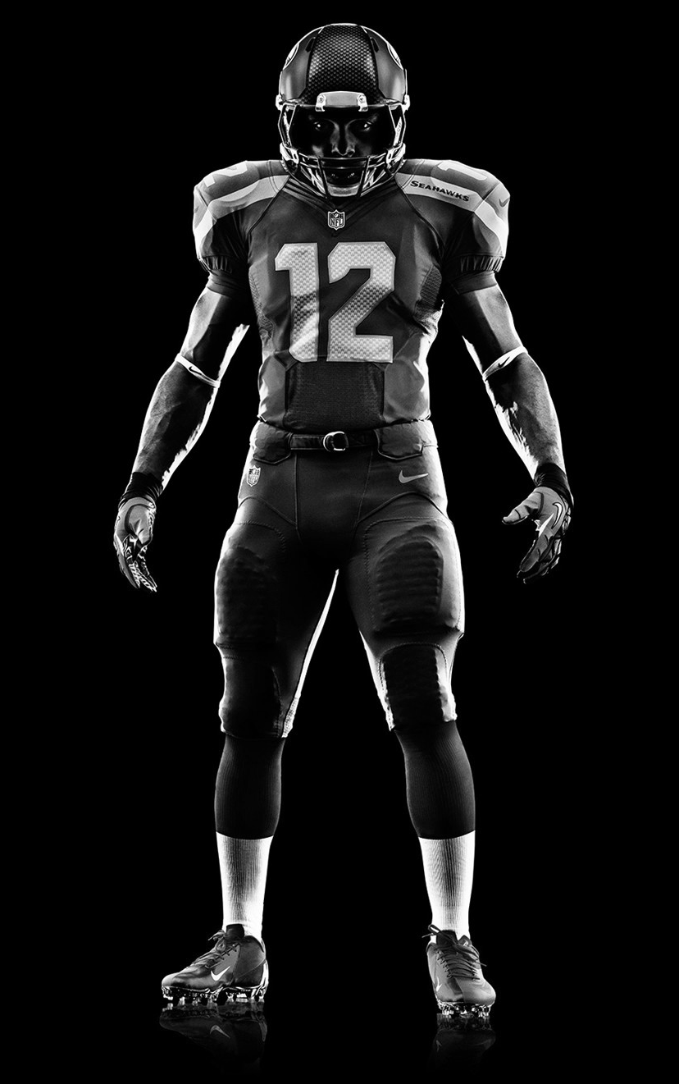
Results

Slide 29
Results
Single Wrist I.M.U.
69% accuracy

Slide 30
Results
Single Wrist I.M.U.
69% accuracy
All 9 I.M.U.
97% accuracy

Slide 31
Results
Single Wrist I.M.U.
69% accuracy
All 9 I.M.U.
97% accuracy
Wrist and Shoe I.M.U.s
90% accuracy
Notes:
Can test different combos for the business.

Slide 32
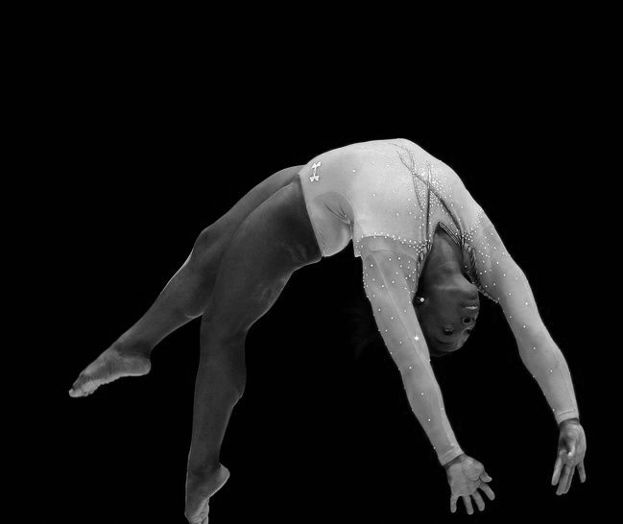
Future Work

Slide 33
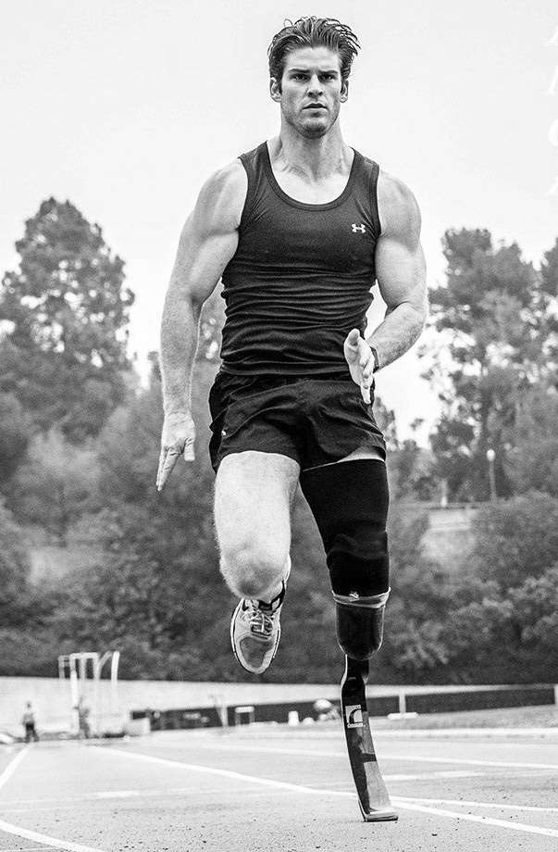
Future Work

Slide 34

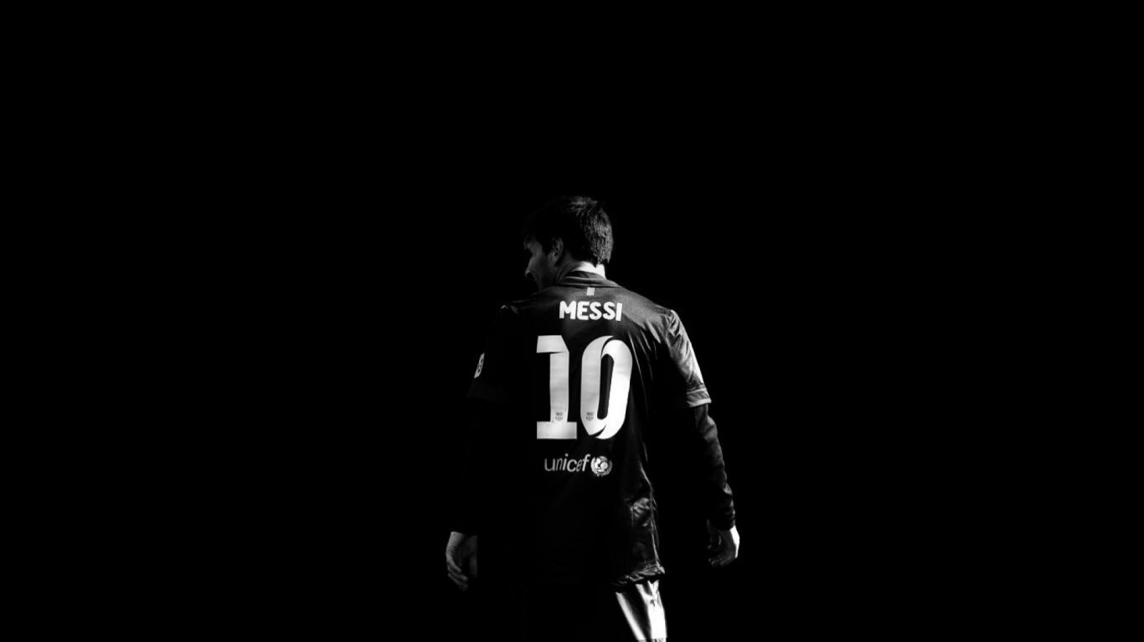
Thank You
D. Alex Lou
Data Scientist | Economist
d.alexlou17@gmail.com
linkedin.com/in/david-alexander-lou
alexlou.squarespace.com
github.com/alou127

Slide 35
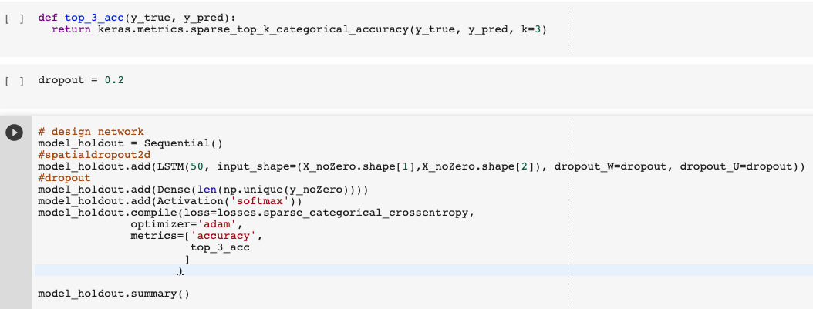
Appendix

Slide 36
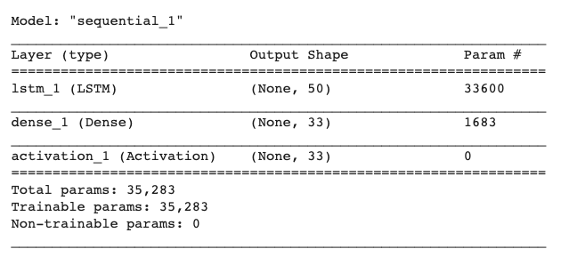
Appendix

Slide 37
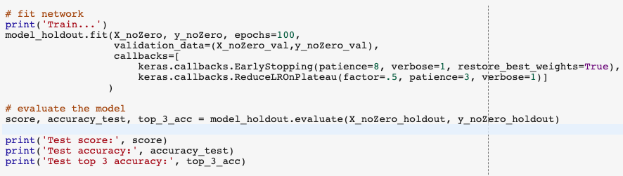
Appendix

Slide 38
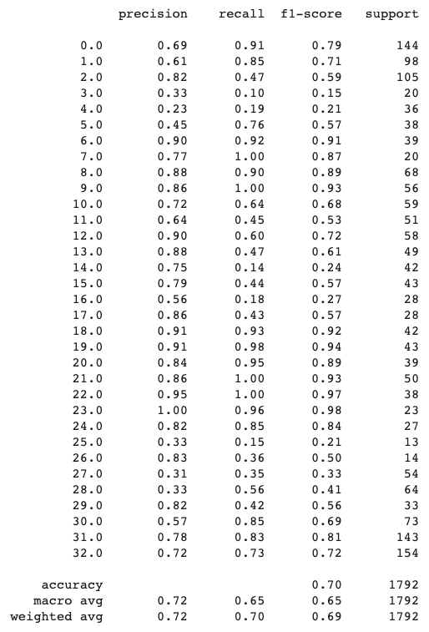
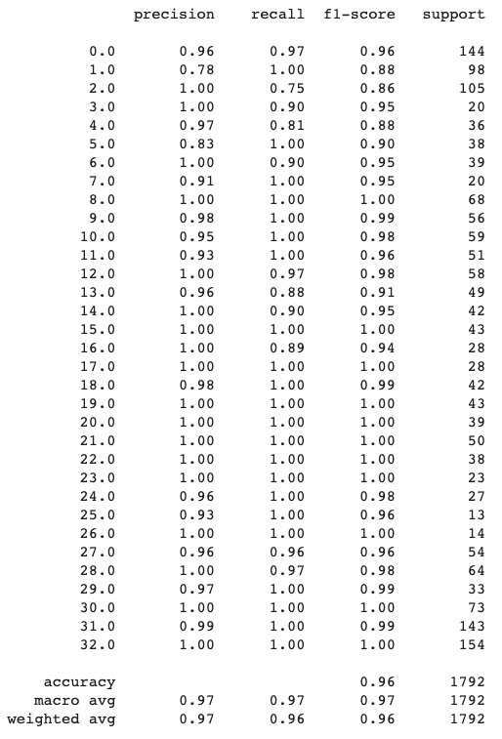
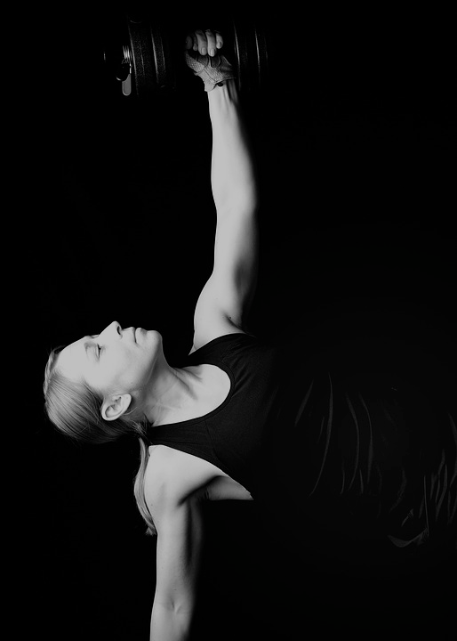
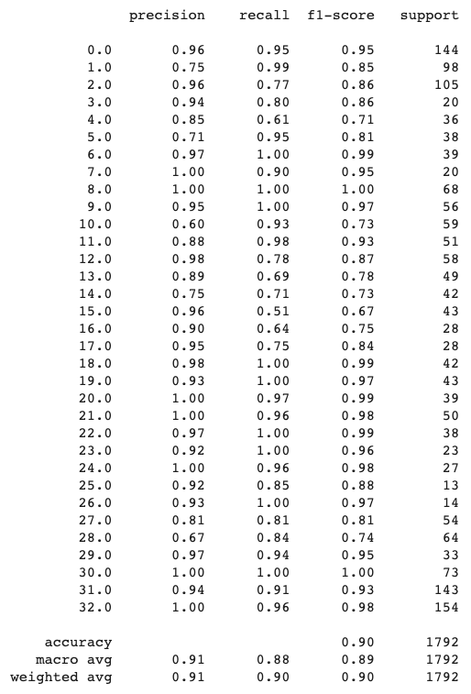
Appendix
Wrist Sensor
All 9 Sensors
Wrist & Shoe Sensor

Slide 39
Appendix
Wrist Sensor
All 9 Sensors
Wrist & Shoe Sensor

Slide 40
Data

